Slide 1
Title: time intervals
Objectives
Calculate time intervals using the 24-hour clock.
Read timetables and calculate time intervals using the 24-hour clock.
Plan
Review time
24-hour clock
Timetables with 24-hour clock

Slide 2
Why is time calculated with
365 days a year
12 months a year
24 hours in a day
12 and 24-hour time
60 minutes in an hour
60 seconds in a minute
Following the tradition set by the Babylonians, these divisions were expressed using the sexagesimal system, a form of counting based on units of 60. Using this, the length of a second became a sixtieth of a sixtieth of an hour, leading to its definition as 1/3600th of an hour.

Slide 3
Measures and Data
Read timetables using 24-hour clock
Calculate time intervals
Objectives
Objective 1
Calculate time intervals using the 24-hour clock.

Slide 4



Day 1: Calculate time intervals using the 24-hour clock.
This is a 24-hour digital clock. What would this time look like on a 12-hour digital clock?
When is it useful to use a
24-hour digital clock rather than a 12-hour digital clock?
1
6
3
0
Hours
Minutes
A school science lesson starts at 10:45 and ends at 11:35.
How long does it last?
Sketch a time number line to represent this on your whiteboard.
How many minutes until 11 o’clock? Remember that we are counting up to 60, not 100…
35 mins
15 mins
10:45
11:00
11:35
15 mins + 35 mins = 50 mins
Notes:
If necessary, revise this strategy, particularly how the whole hour can be used when counting up, i.e. 15 minutes from 10:45 to 11, then 35 minutes to 11:35, so the total length of the Science lesson is 15 + 35 minutes = 50 minutes.

Slide 5

Day 1: Calculate time intervals using the 24-hour clock.
A P.E. lesson starts at 13:30 and ends at 14:45.
How long does it last?
Sketch a time number line to represent this on your whiteboard.
Compare your timeline with your partner's.
A singing lesson starts at 11:50 and ends at 12:35.
How long does it last?
Sketch a time number line to represent this on your whiteboard.
Compare your timeline with your partner's.
Notes:
Children can now go on to do differentiated GROUP ACTIVITIES. You can find Hamilton’s group activities in this unit’s TEACHING AND GROUP ACTIVITIES download.
WT: Calculate time intervals on the class timetable.
ARE/GD: Calculate time intervals on the class timetable, then compare with lesson durations in a younger class.

Slide 6
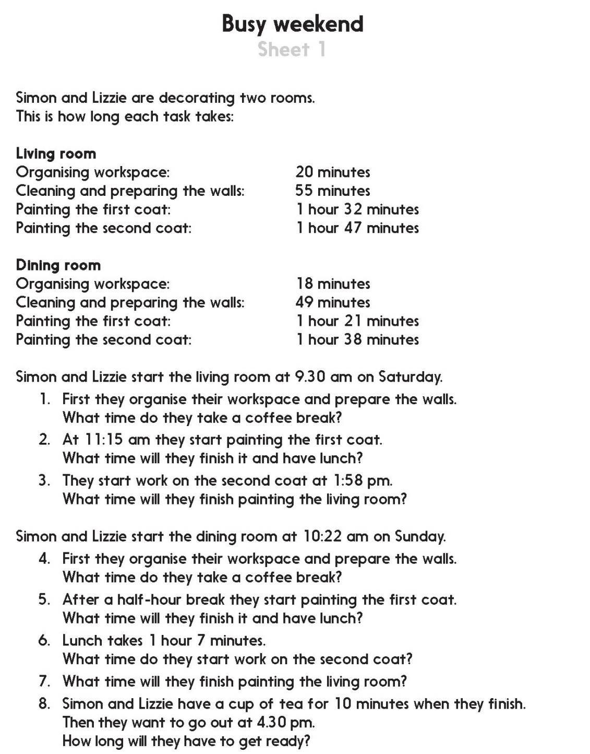
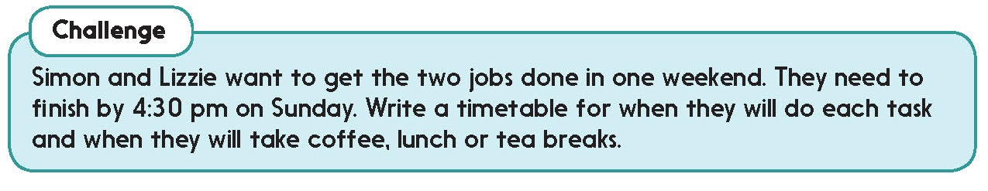

Challenge
Notes:
The Practice Sheet on this slide is suitable for most children.
Differentiated PRACTICE WORKSHEETS are available on Hamilton’s website in this unit’s PROCEDURAL FLUENCY box.
WT/ARE/GD: Calculate elapsed times. Create a schedule for DIY tasks (Sheet 1).

Slide 7
Measures and Data
Read timetables using 24-hour clock
Calculate time intervals
Objectives
Objective 2
Read timetables and calculate time intervals using the 24-hour clock.

Slide 8

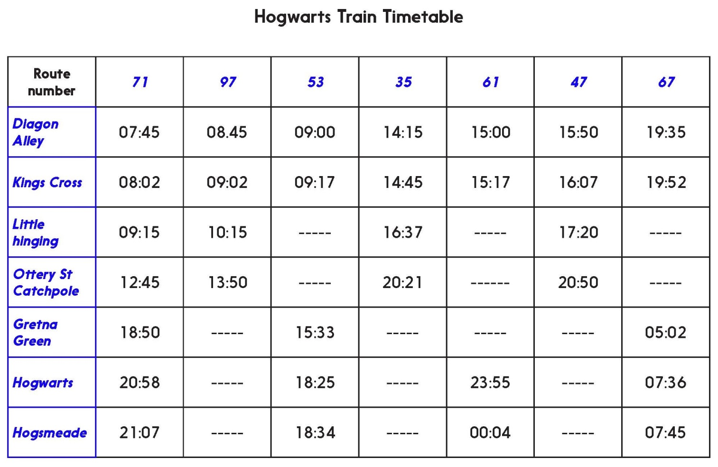
Day 2: Read timetables and calculate time intervals using the 24-hour clock.
What time does the 08:45 reach Ottery St Catchpole? Write both the 24-hour and 12-hour times on your whiteboard.
I am going to show a time in 12-hour format.
Convert it to 24-hour format, search for it on the timetable and write the corresponding place name on your whiteboard.
Five to midnight.
2 minutes past 9 in the morning.
20 past 5 in the afternoon.
10 to 7 in the evening.

Slide 9
Day 2: Read timetables and calculate time intervals using the 24-hour clock.
How long does the 08:45 from Diagon Alley take to reach Ottery St Catchpole?
I am going to ask you to calculate time intervals.
Draw time-lines to help.
How long does the 19:52 from Kings Cross take to reach Hogsmeade?
Which is the fastest train between Kings Cross and Hogwarts?

Slide 10

Day 2: Read timetables and calculate time intervals using the 24-hour clock.
Whole
Class
activity
For each route, find how long the train takes between Diagon Alley and Kings Cross. What do you notice?
Investigate journey times between other pairs of stations. In each case, find the quickest and the slowest journey times.
Notes:
Today’s GROUP ACTIVITY is a whole class activity. You can find more details in the unit’s TEACHING AND GROUP ACTIVITIES download.
WT/ARE: As above.
GD: Four trains travel all the way from Diagon Alley to Hogsmeade. What are the quickest and the slowest times for this journey?

Slide 11
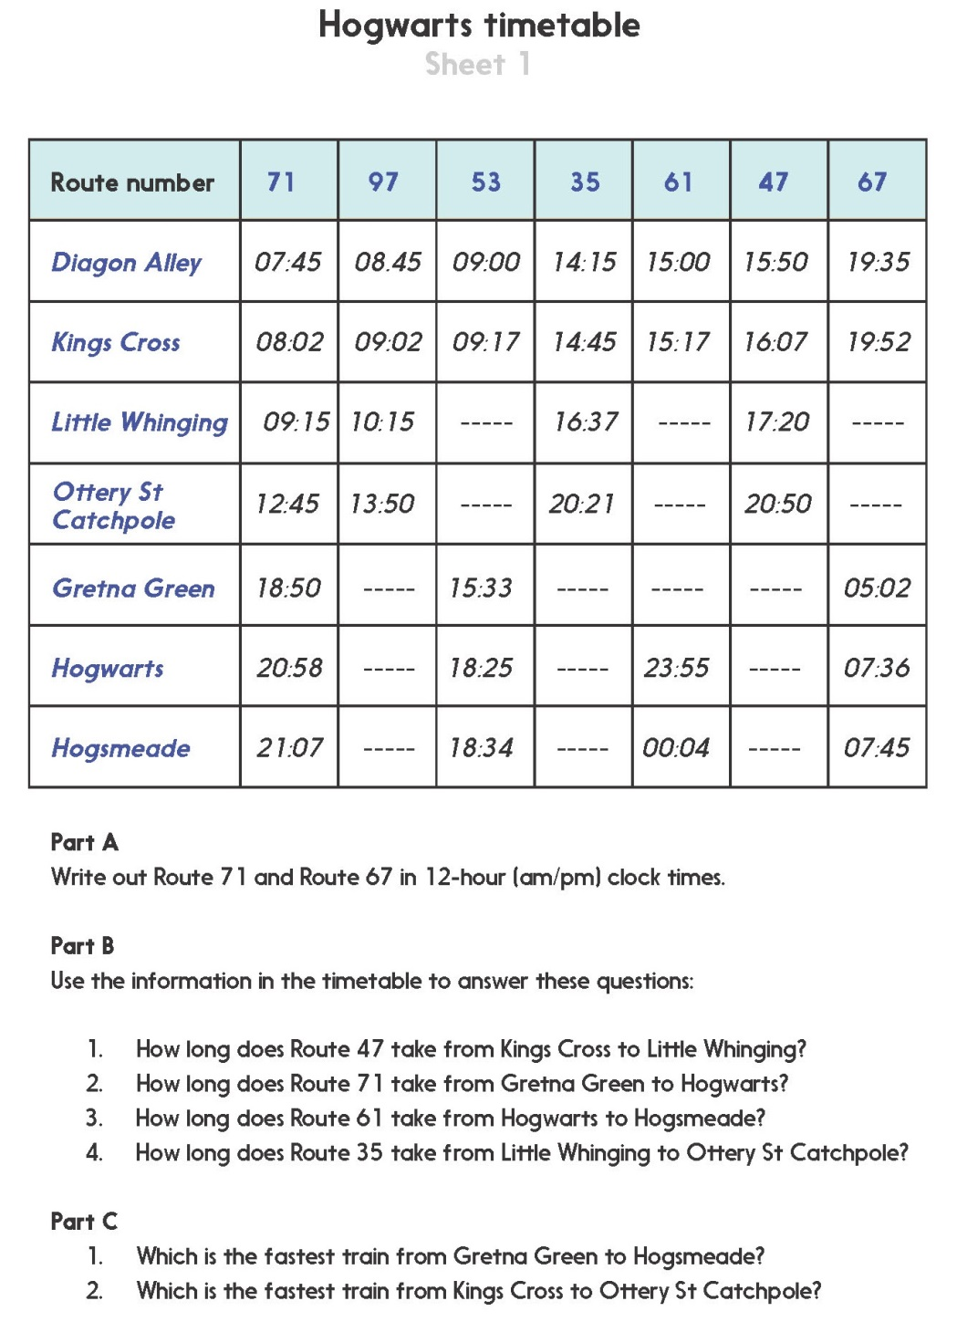
Notes:
The Practice Sheet on this slide is suitable for most children.
Differentiated PRACTICE WORKSHEETS are available on Hamilton’s website in this unit’s PROCEDURAL FLUENCY box.
WT/ARE/GD: Interpret a fictional timetable, including reading times and calculating durations (Sheet 1).

